Slide 1
The 2016 Race to Empty Attack on the DAO
Wesley Harmon
CS453 Emory University

Slide 2
A quick recap:
What do we need to know?
Ethereum
Smart contracts
The DAO

Slide 3



ETHEREUM
A Distributed Global Computer
Prev. block √
Timestamp √
State √
Transactions √
Etc...
Block 2305
Block 2306
Hashed and secure
(also just a glorified linked list can be accessed wherever there is internet)
Block 2307
Account (private keys) and contract (controlled by code) interactions

Slide 4


SMART CONTRACTS
A typical Über example!
GPS coordinate A
GPS coordinate B
if (GPS_A(blue)==GPS_A(yellow) && GPS_B(blue)==GPS_B(yellow)
after B has been reached) {
PROFIT!
}
How can we set up a system that guarantees compensation?
PROGRAMMABLE, IMMUTABLE!

Slide 5
“THE DAO”
The Decentralized Autonomous Organization
Basically just a gofundme, venture capital-like system
  A decentralized app
Transactions are done with smart contracts!

Slide 6
THE PROBLEM AND THE SOLUTION
The attack
  What happens when there is a “feature” in the code?
The solutions
  Technical approaches
  Approach approaches
    Soft fork
    Hard fork: where the bad guy got away
Some takeaways:
  How does this contribute to secure design?
  Impacts on existing technology
  What’s next?

Slide 7
DEMO

Slide 8
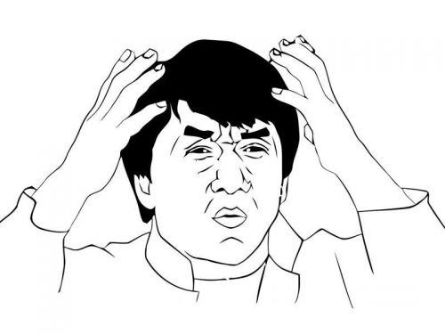
THE ACTUAL CODE: splitDAO()
function splitDAO (uint _proposalID, address _newCurator) noEther onlyTokenholders returns (bool _success)
{
...
uint fundsToBeMoved = (balances[msg.sender] * p.splitData[0].splitBalance) /
p.splitData[0].totalSupply;
if (p.splitData[0].newDAO.createTokenProxy.value(fundsToBeMoved)(msg.sender) == false)
throw;
...
Transfer(msg.sender, 0, balances[msg.sender]);
withdrawRewardFor(msg.sender); // PROFIT
totalSupply -= balances[msg.sender]; balances[msg.sender] = 0;
paidOut[msg.sender] = 0;
return true;
}

Slide 9
withdrawRewardFor()
function withdrawRewardFor(address _account) noEther internal returns (bool _success) {
if ((balanceOf(_account) * rewardAccount.accumulatedInput()) / totalSupply < paidOut[_account])
throw;
uint reward = (balanceOf(_account) * rewardAccount.accumulatedInput()) / totalSupply - paidOut[_account];
if (!rewardAccount.payOut(_account, reward))
Throw;
paidOut[_account] += reward;
return true;
}
Here’s the culprit
The rewardAccount is managed by the attacker,
The bad stuff happens when this function gets called…

Slide 10
payOut()
function payOut(address _recipient, uint _amount) returns (bool) {
if (msg.sender != owner || msg.value > 0 || (payOwnerOnly && _recipient != owner))
throw;
if (_recipient.call.value(_amount)()) {
PayOut(_recipient, _amount);
return true;
} else {
return false;
}
}

Slide 11
USEFUL INFORMATION
Creator of the malicious DAO: 0x4a574510c7014e4ae985403536074abe582adfc8
Start of the drain: 2016–06–17 03:34:48 UTC, block 1718497
The malicious child DAO aka “The Dark DAO”: 0x304a554a310c7e546dfe434669c62820b7d83490
Malicious token holders aka “Dark token holders”. These are the accounts that control the malicious DAO: 0xc0ee9db1a9e07ca63e4ff0d5fb6f86bf68d47b890xf835a0247b0063c04ef22006ebe57c5f11977cc4
Curator of the malicious DAO and creator of the malicious proposal: 0xb656b2a9c3b2416437a811e07466ca712f5a5b5a
The malicious proposal from which the attack was launched: #59, aka “lonely, so lonely”, 2016–06–08 05:38:01 UTC, before the recursion call bug went public on 2016–06–10

Slide 12
THE SOLUTION
Maybe there is a way to detect these callback functions?
Let’s take a look at some smart stuff from some scientists!

Slide 13
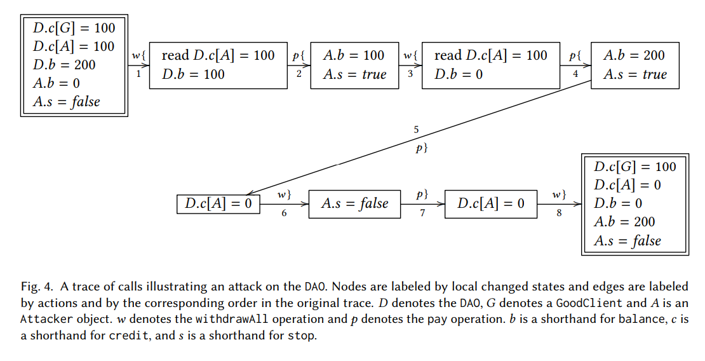
A CALLBACK TO SOME PREVIOUS CODE

Slide 14
EFFECTIVELY CALLBACK-FREE OBJECTS
dynamicallyECF: perform an “equivalent” execution without callbacks, compare states and results
staticallyECF: all possible executions of an object are dynamically ECF
  Languages like Solidity support Turing complete languages, therefore checking if a contract is ECF is undecidable
dECF is more applicable here anyways

Slide 15
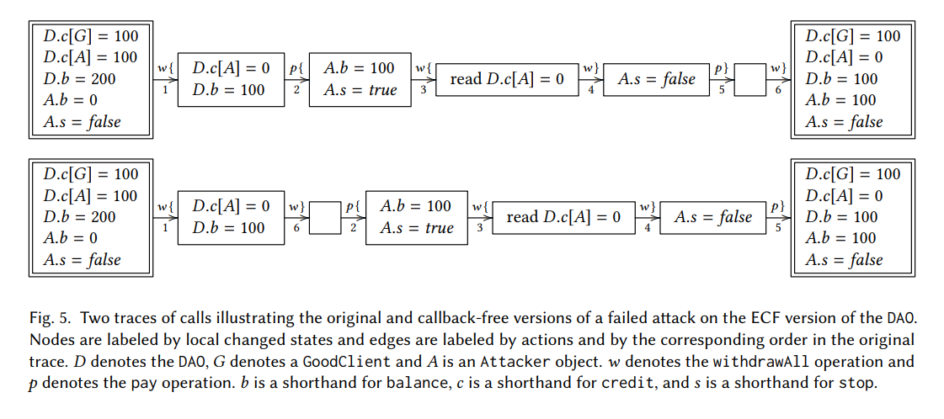
A NAÏVE APPROACH TO DETECTION

Slide 16
THE APPROACH APPROACHES
Soft-fork:
  Just freeze all the assets and problem solved?
Hard-fork:
  Try to set up a new contract only for withdrawing
  Allow tokenholders to withdraw
  The DAO dissolves

Slide 17
What to do next time?
A purely functional language with a rich type system is needed (with ECD objects, etc.). If we can't have that right now…
All calls that send to untrusted address should have a gas limit
Balances should be reduced before a send, not after one
Events should probably have a Log prepended to their name.
The splitDAO function should keep permanent track of the status of each possible splitter, not just through token tracking (balances, credit, accumulatedInput)

Slide 18
THE TAKEAWAYS + Questions?
Decentralized apps must be rigorously checked for bugs
  The ultimate war between white hats and black hats!
Smart contracts represent something bigger: DIGITAL LAW
Lessons sometimes have to be learned the hard way
The applications are endless, and awesome!

Slide 19
SOURCES
http://www.cs.tau.ac.il/~shellygr/pubs/2018-popl-1.pdf
https://medium.com/@MyPaoG/explaining-the-dao-exploit-for-beginners-in-solidity-80ee84f0d470
http://vessenes.com/deconstructing-thedao-attack-a-brief-code-tour/
https://medium.com/@oaeee/the-rise-of-the-dark-dao-72b21a2212e3
https://ethereum.github.io/browser-solidity/#version=soljson-v0.4.18+commit.9cf6e910.js

